Slide 1
2nd Internal Check

Slide 2
Presentation Outline
Software Design:
Data Visulaization
Education Materials:
Articles & Recipe
‘Ask A Professional’
Eye Exercise
Users Questionnaire
Imprementation and promotion of our app
7. Code
8. Q&A

Slide 3
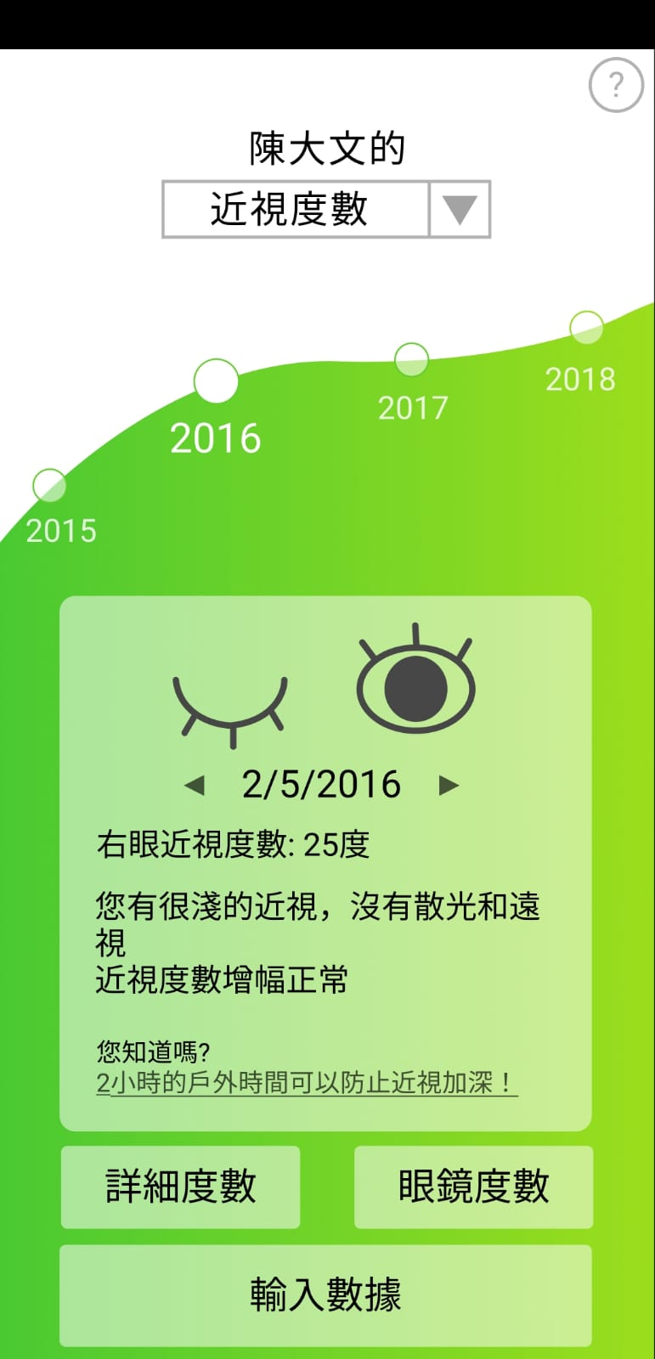
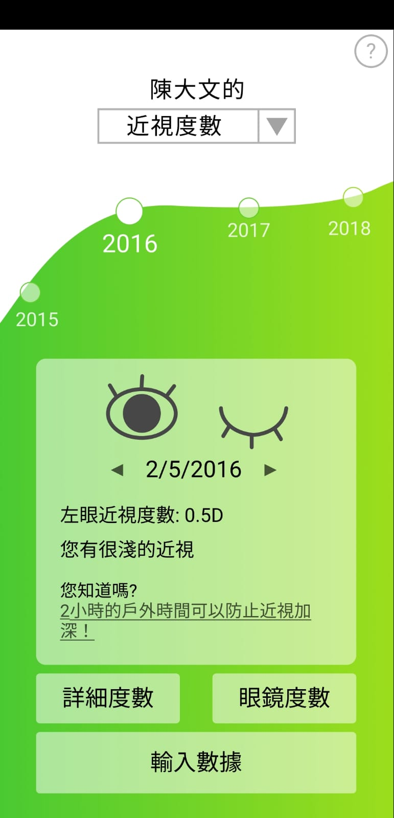
Data Visualization
Switch the graph to display different record
e.g. Myopia degree/Hyperopia degree
Show right eye data first to match with convention
Overview of eye health and Record explanation
Article recommendation
Notes:
Color things:
absoluate scale
the rate of changes?? the changes btw 2 check-ups?
(encouragement messages to them → inside the design and explanation of the chart)

Slide 4
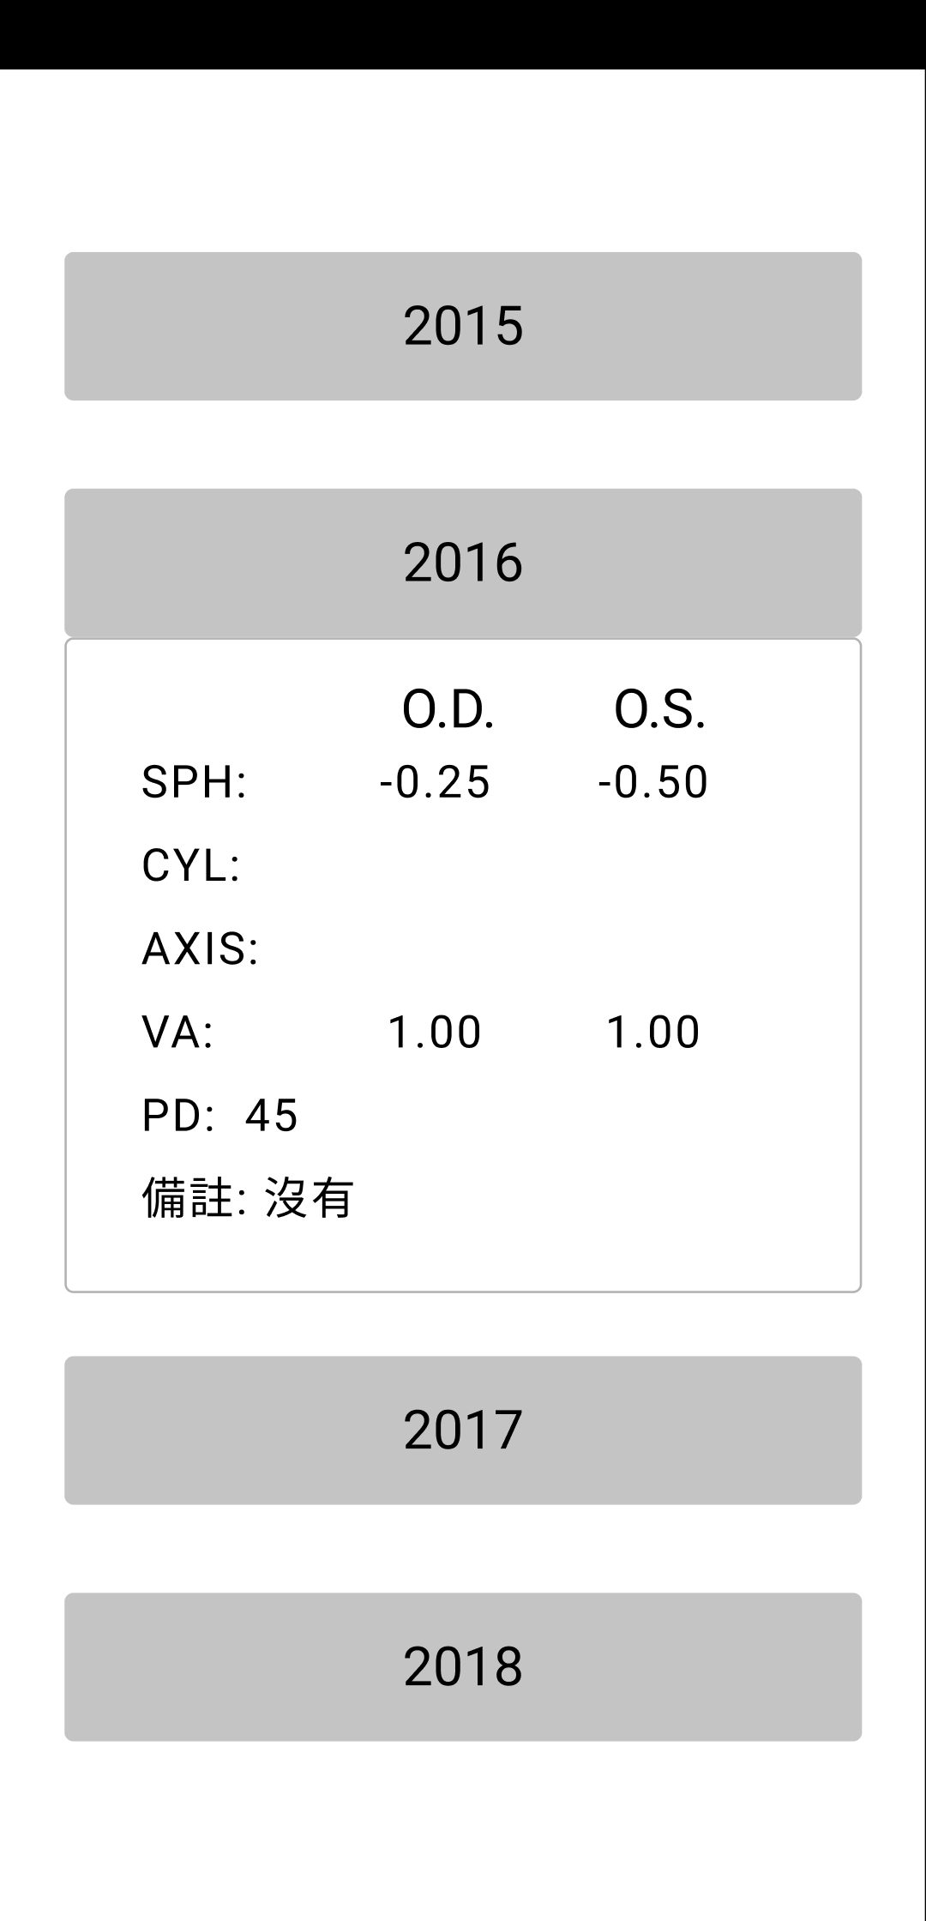
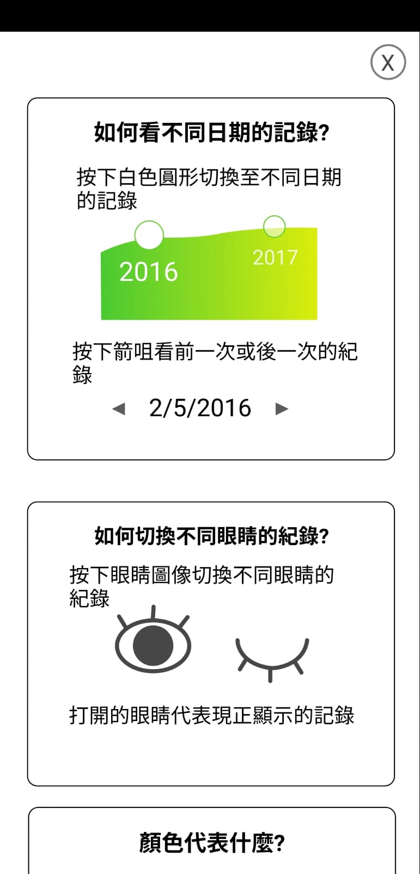
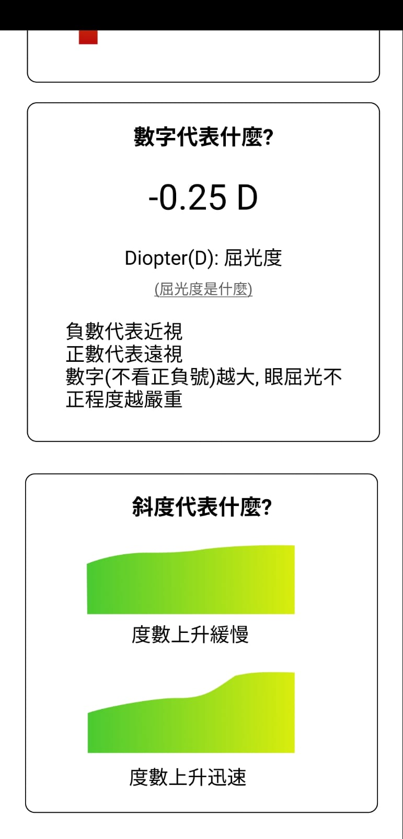
Users can only view their detail records by year
Tutorial Page

Slide 5
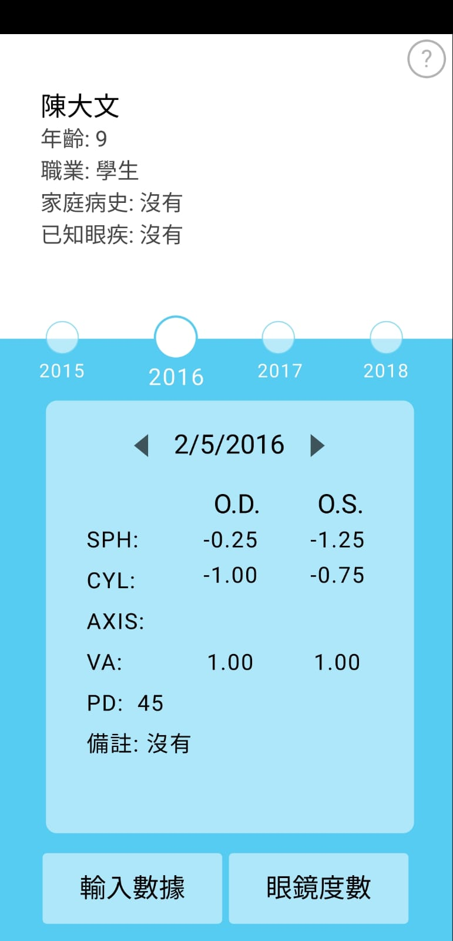
Professional side
Customers’ personal information
Cleaner look for professionals
Pick which record to view
List view of all record data, and remarks

Slide 6
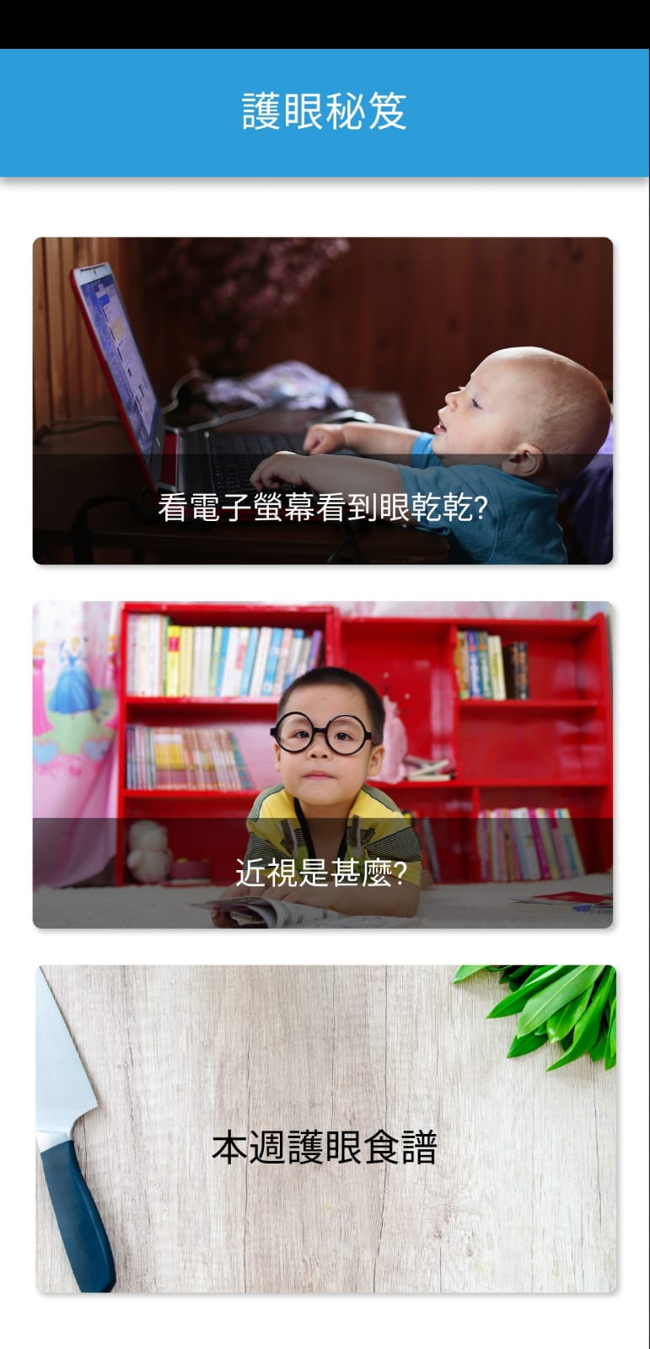
Articles and Recipe

Slide 7

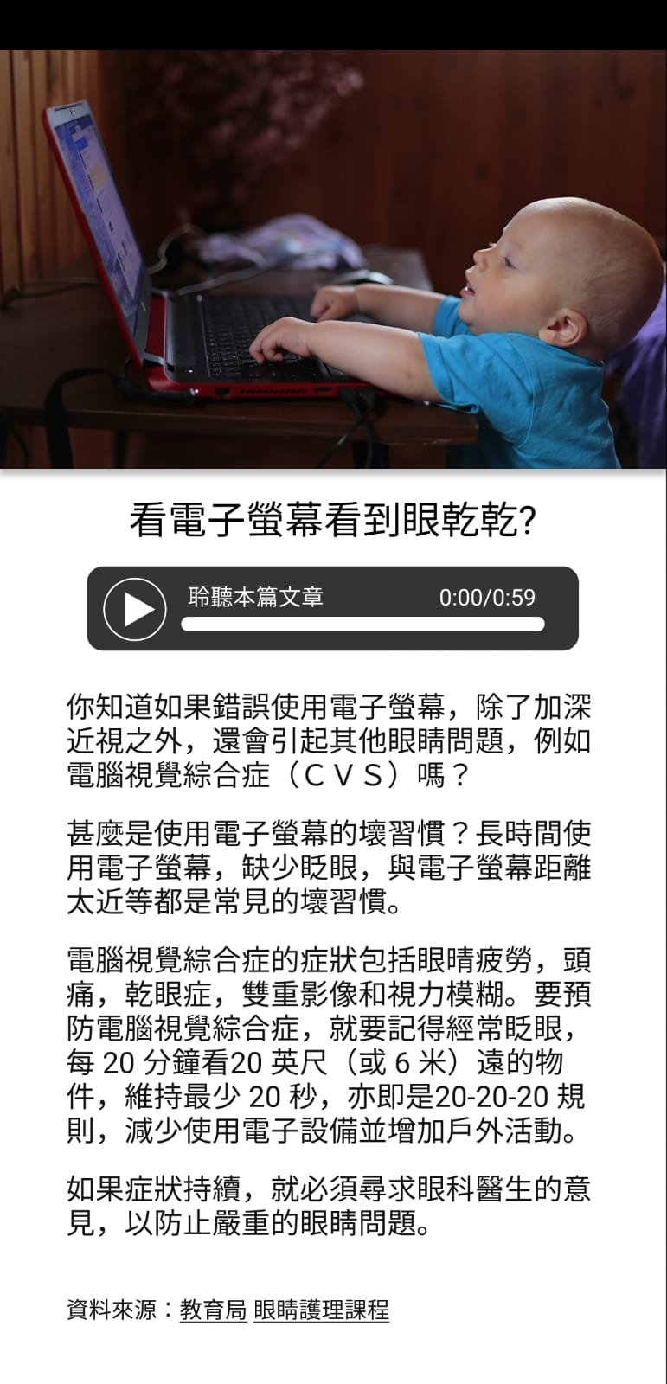
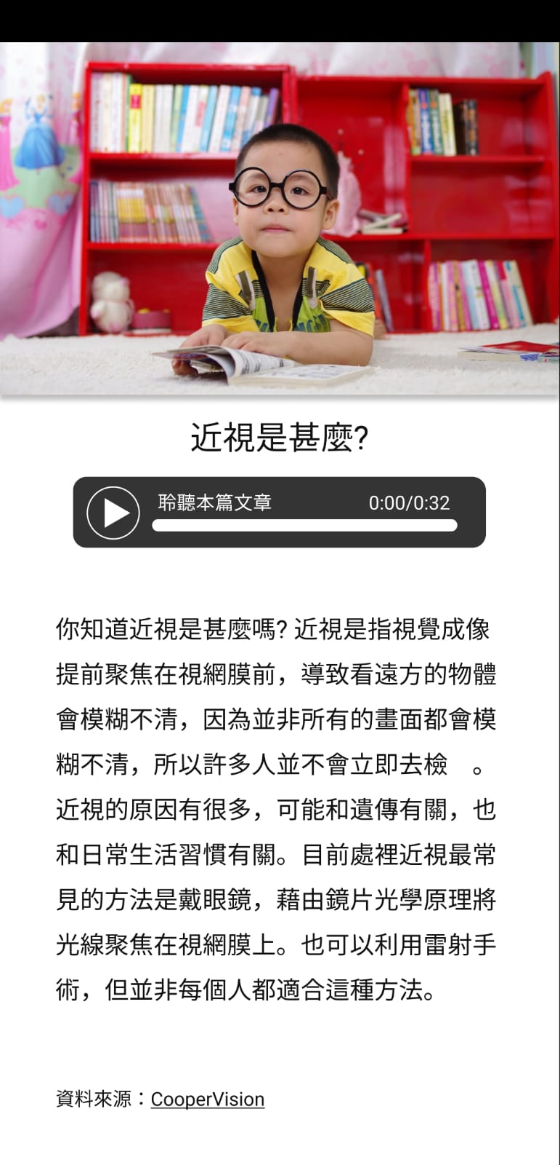
Articles and Recipe
Article 1
Article 2
Article 1 sample recording
Article 2 sample recording
Recording included so that users do not need to read from electronic devices
Short 2-3 min read educational article
Provide the link(s) to article source to encourage further reading

Slide 8
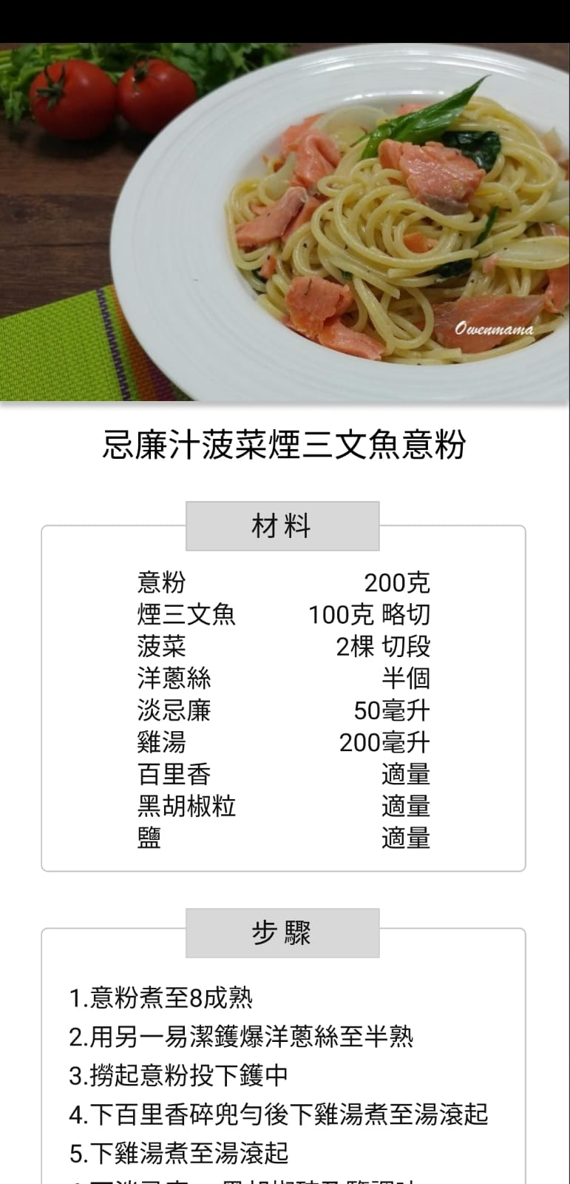
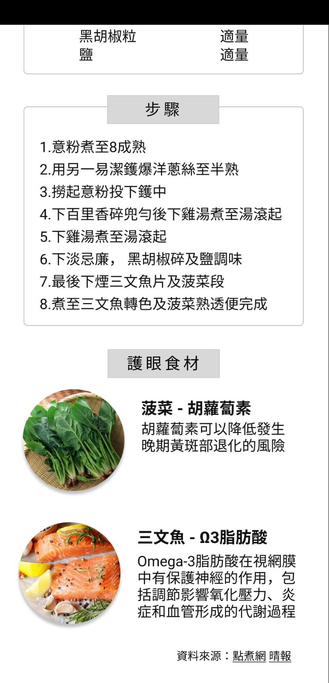
Articles and Recipe
Ingredients and steps
Show the nutrition of main ingredients

Slide 9
Ask a professional
Users view other people’s questions
We received the answers and publish it in our app
Users submit question in our app
We filter the questions and forward the selected questions to professionals
The app send the question to our email

Slide 10
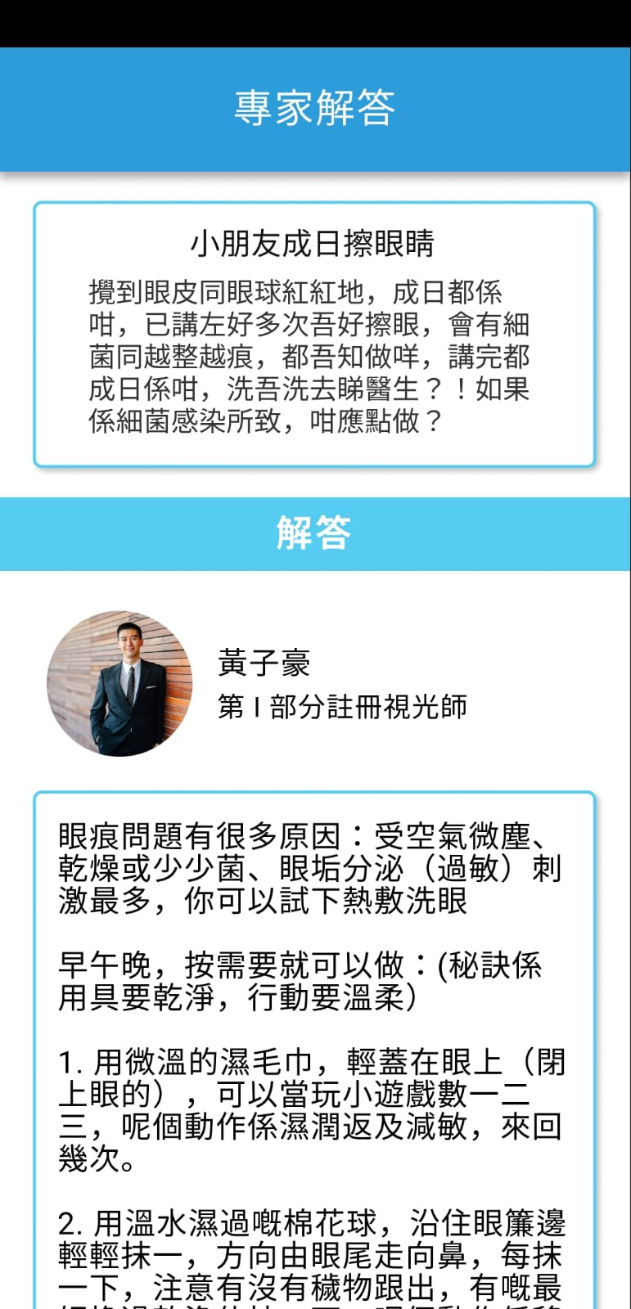
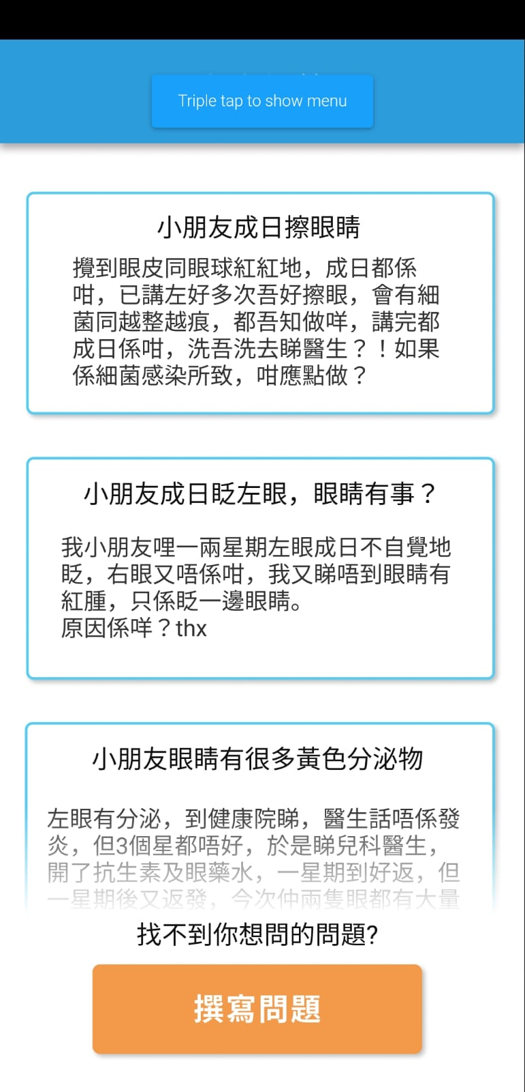
Ask a professional
List the question from other users
Profile of the professionals
Get answer from professionals

Slide 11
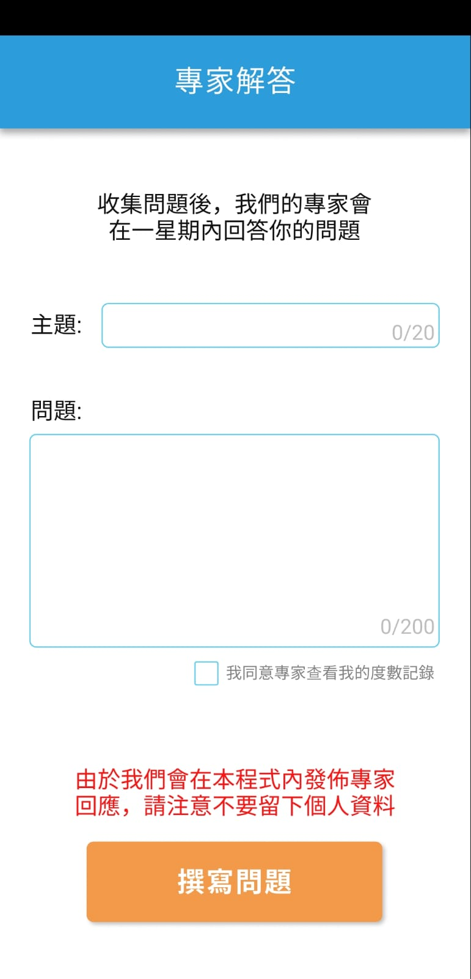
Users can write their own question
Check box: whether they will allow professionals to access their eye check up data

Slide 12

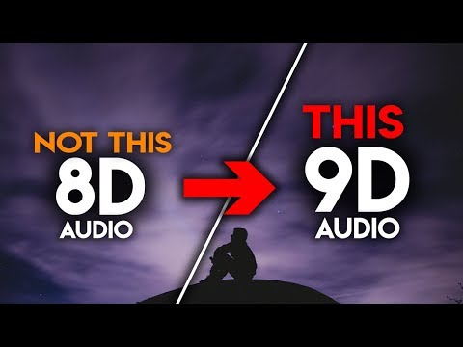

Eye Exercise
8D audio (feel the sound from left & right)
Feel 8D audio →
Left and Right Direction
- our voice instruction (8D audio effect)
-----------------------------------------
Other directions:
Rotate clockwise & anticlockwise
our voice instruction (8D audio effect)
Notes:
For listen clearly

Slide 13
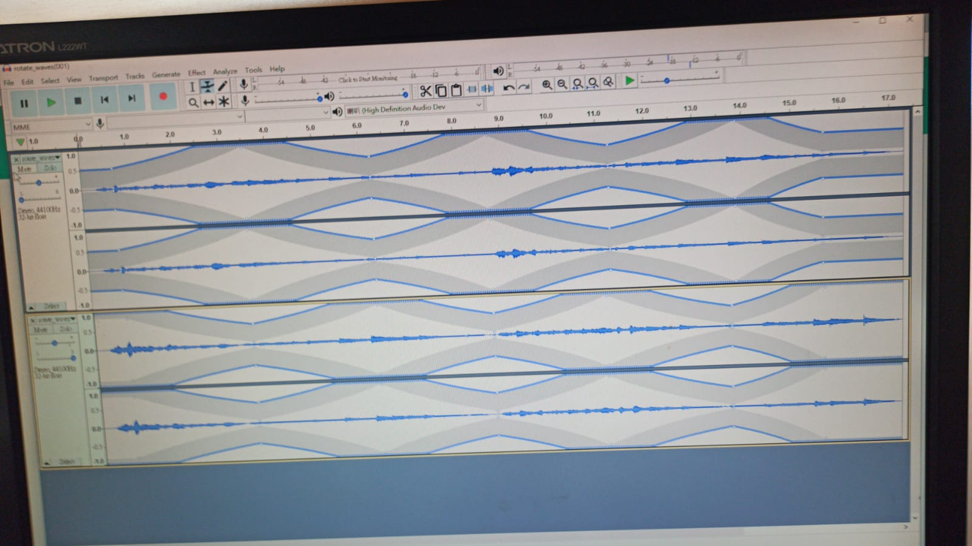
Eye Exercises audio intructions demo
Need to use earphone to listen to the effect
Youtube link: https://youtu.be/o83DjzPK1zY (eye_rolling)
https://youtu.be/IerPxM974Dw (left_to_right_eye)

Slide 14
Eye Exercise (Detail)
The process (total: 200 seconds) (3.3 mins): voice with relaxing music (some 8D audio effects)
1 | Close your eyes (20s)
2 | Look at the farthest object (at least 20ft 6m) [prefer green object] (20s)
3 | Look up (5s), Look down (5s), Look left (5s), Look right (5s)
4 | Look top left and down right (5s), Look top right and down left (5s), Look down left and top right (5s), Look down right and top left (5s)
5 | Rotate clockwise (10s), Rotate anticlockwise (10s)
6 | Look at far object (5s), Look at close object (5s), Look at far object (5s), Look at close object (5s)
7 | Close your eyes again (20s)
8 | While closing your eyes: Turn your eyeballs up (5s), Turn your eyeballs down (5s), Turn your eyeballs left (5s), Turn your eyeballs right (5s)
9 | While closing your eyes: Rotate your eyeballs clockwise (10s), Rotate your eyeballs anticlockwise (10s)
10 | Eye Open and close (10s), Close your eyes and Relax (10s)
Notes:
Exercises: (every exercise is 20s), do 3-4, within 2min
Close your eyes for 20s
Look at the farthest object(at least 20ft(6m)) for 20s
Look up 5s Look down 5s up5s down5s
Look left 5s right 5s left 5s right 5s
Rotate clockwise 10s, rotate anticlockwise 10s
Look at far object 5s, close object 5s, far object 5s, close object 5s

Slide 15
Achievement List
Gift: e.g. Dr Dick Lo coupons (glass lens)
Item List: e.g. To-do-list (just like a checklist)
Achievement Name: e.g. book expert, eye health chef, eye tips expert etc
Badges: visual representation of the achievement gained by users
Method: Earn credits by doing tasks with 3 levels (daily & long-term elements), get 100 credits to exchange for 1 coupon
Easy | Moderate | Challenging
less time consuming | time consuming | more time consuming
Notes:
(10 items) Daily task:
e.g. read 3 articles =>
e.g. register eye check up
e.g. do 2 eye exercises
e.g. cook a meal
e.g. invite people to download
e.g. outdoor
(10 items) Long-term: time-dependent
e.g. Ask 1 question to the opticians
e.g. 3 day contiuous exrecises
e.g. 7day contiuous exercises
e.g. 30-day contious exercises
e.g. Record the data
e.g Record the data (only count professional input the data)

Slide 16
Item lists
Daily Tasks | Credits (1 coupon = 100 cd) | Long Terms (e.g. 1 year goal) | Credits (1 coupon = 100 cd)
Listen 3 articles | 10 credits (moderate) | Ask 2 questions to Doctor | 10 credits (easy)
Do 3 eye exericses | 10 credits (easy) | Record your own data regularly | 10 credits (moderate)
Cook 1 meal | 10 credits (moderate) | Record your eye-check up data | 10 credits (easy)
Input your 1 meal pic | 10 credits (moderate) | Do questionarie (random) | 10 credits (moderate)
Do outdoor activities | 10 credits (moderate) | Do a whole detail questionaire each half year | 10 credits (challenging)
Input exercise pic | 10 credits (easy) | Stop using your phone for 1 day (weekend’holiday) | 10 credits (easy)
Register/go 1 eye check up | 10 credits (easy) | Do 12 exercises regularly | 10 credis (moderate)
Invite ppl to download | 10 credits (easy) | Do eye exercises regularly | 10 credits (moderate)
Input eye health tips | 10 credits (easy) | Cook eye health meal | 10 credits (moderate)
Share 1 eye health routine by post | 10 credits (moderate) | Read 12 short articles | 10 credits (Challenging)
To-do-lists
100 credits
→ earn a coupon !!!
Notes:
come up with some items that can be achieved by only the app
no need point system, just finish 3 tasks per day, come up with a way to limit the exploit way.
Maybe keep it simple first and dun include long term task first
(10 items) Daily task:
e.g. read 3 articles =>
e.g. register eye check up
e.g. do 2 eye exercises
e.g. cook a meal
e.g. invite people to download
e.g. outdoor
(10 items) Long-term: time-dependent
e.g. Ask 1 question to the opticians
e.g. 3 day contiuous exrecises
e.g. 7day contiuous exercises
e.g. 30-day contious exercises
e.g. Record the data
e.g Record the data (only count professional input the data)

Slide 17
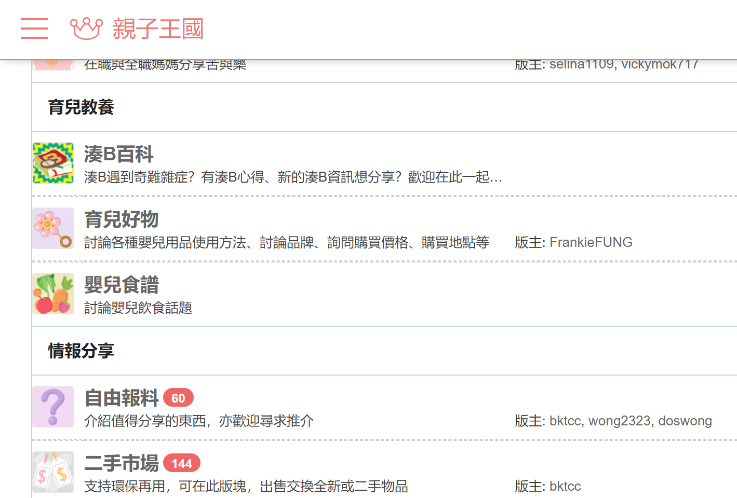
Evaluation - Test group
Recruit 100 parents with children age from 4 to 8 as a test group to evaluate their behavioural change and collect feedback for our application
Recuitment platform: BabyKingdom(a popular online forum among HK parents), our friends and relatives, social media
Notes:
Introduce your detailed plan to receive feedback from stakeholders (e.g. medical staff, parents, children) for the next round of iteration.
Goal:
-behavior changes
-user feedback

Slide 18
Evaluation - Questionnaires
“Before and after” :
Target Behaviour change:
· ↑ outdoor activity
· ↓ exposure to screens
· ↑ good eye habits
· ↑ keep track on own eye data
Two Types of Questionnaires:
“Before and after”
“User Experience”

Slide 19
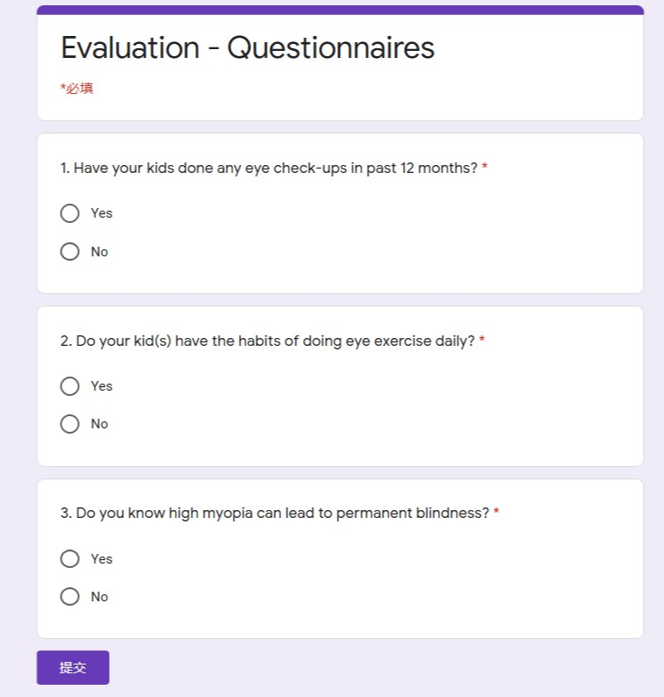
“Before and after” Questionnaires:
All Yes/No Questions
Repeat questions after 1 month
Comparison result

Slide 20
Proposed Questions (before and after):
1. Have your kids done any eye check-ups in past 12 months? Ans: Yes/No
2. Do you remember your eye data from your last eye check-ups? Ans: Yes/No
3. Do your kids have at least 1 hour of outdoor activities daily for past 7 days? Ans: Yes/No
4. Do your kid(s) have the habits of doing eye exercise daily? Ans: Yes/No
5. Do you record your kid(s) eye check-up results regularly? Ans: Yes/No
6. Do you know what to do to help your kid(s) maintain good eye health? Ans: Yes/No
7. Do you know high myopia can lead to permanent blindness? Ans: Yes/No
8. Do you know what is bad eye using habits? Ans: Yes/No
9. Do you know what is good eye using habits? Ans: Yes/No
10. Do your kids use electronic devices daily? Ans: Yes/No

Slide 21
Proposed Questions (user experience):
1. Are you enjoying the application?
Ans:
Yes→ Could you please leave us some precious comments to let us know what you think on our apps. Open google play for them to comment.
No→ Could you please let us know which part of our apps you are not satisfied with? Show in-app comment session for them to leave their comments

Slide 22


Implementation Plans
Implementation Method:
(i) Available on Google Play
(ii) Promotion on Baby-Kingdom
Mitigation: Use digital coupon to attract the test group, obtain behavioural change data, use the result to promote the benefits of our application. Attract more shops to provide digital coupon.
Future Challenges: Getting sufficient users
Notes:
Explain the how you are going to implement your solutions, possible challenges and their mitigation strategies.

Slide 23
Code

Slide 24
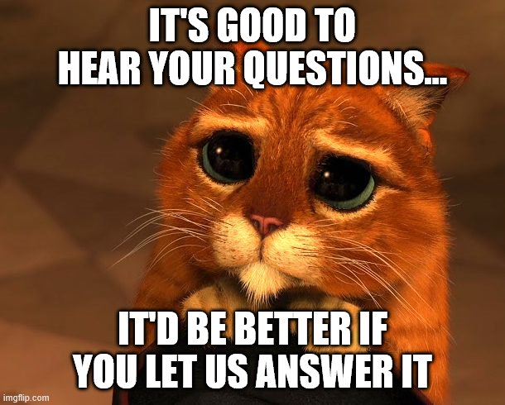
Any Questions regarding software design?

Slide 25
Any Questions regarding edication part?

